Slide 1
TELENGANA GROWTH ANALYSIS

Slide 2
Problem Statement
Telangana is one of the fastest-growing states in India and one of the states with an open data policy.
Peter Pandey is an aspiring data analyst looking for a project with real-time data to add to his portfolio. He wanted to analyse Telangana’s growth among different sectors quantitatively and provide useful Insights to the Telangana government that would help them to make data-informed decisions that would further support the growth of the state..

Slide 3
Technologies used
Python -- Used pandas merging and joining domestic, foreign visitors data and other useful data. Data cleaning, transformation, performing EDA are all done with pandas. Used seaborn and matplotlib for data visualization. Used BeautifulSoup4 for scraping data from Telangana website for the purpose extracting population data.
Sql – Used for querying and manipulating data to answer all important questions.
PowerBi – Used for data visualization, calculating all important metrics through dax measures, data modelling and data transformation

Slide 4
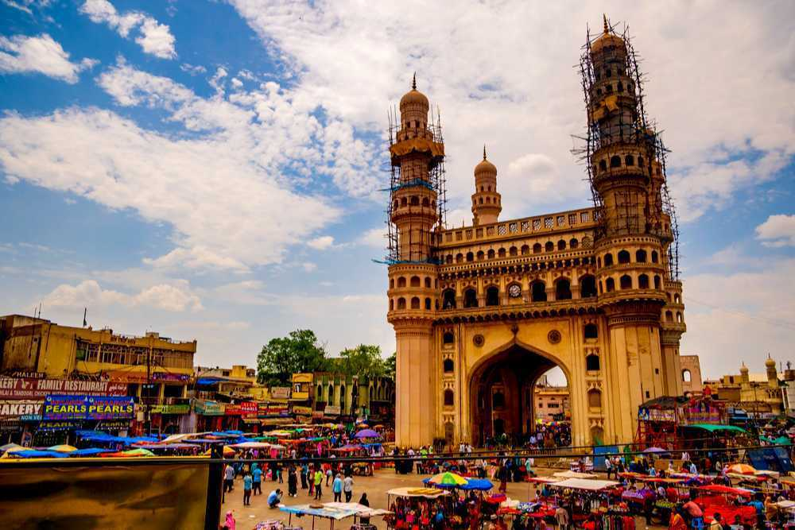
About Telengana
Telangana is a landlocked state in India situated in Southern part of the Indian peninsula on the high Deccan Plateau. It is the eleventh-largest state and the twelfth-most populated state in India as per 2011 census. On 2 June 2014, the area was separated from the northwestern part of Andhra Pradesh as the newly formed state of Telangana, with Hyderabad as its capital.
The economy of Telangana is the ninth-largest in India, with a gross state domestic product (GSDP) of ₹9,572,071 million (equivalent to ₹11 trillion or US$140 billion in 2023) and has GSDP per capita of ₹320,000 (US$4,000). Telangana has scored 0.705 human development index.
The state has emerged as a major focus for robust IT software, industry and services sector. The state is also the main administrative center of many Indian defence aerospace and research labs like Bharat Dynamics Limited, Defence Metallurgical Research Laboratory, Defense Research and Development Organization and Defence Research and Development Laboratory.

Slide 5
STAMPS

Slide 6
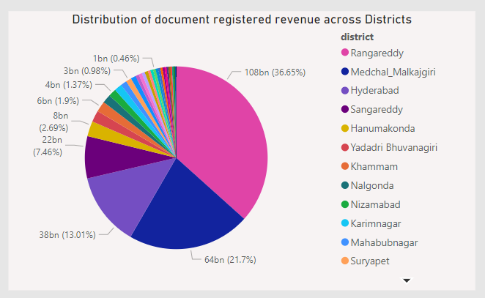
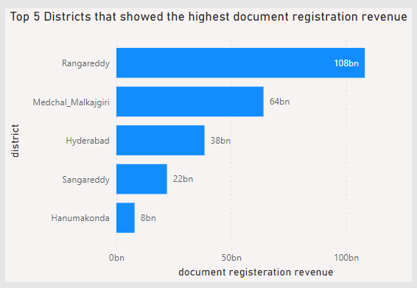
Q. How does the revenue generated from document registration vary across districts in Telangana? List down the top 5 districts that showed the highest document registration revenue growth between FY 2019 and 2022.
Insights:
Rangareddy contributes 36.65% to revenue generated from document registration.
Medchal Malkajgiri contributes 21.7% to revenue generated from document registration.
Hyderabad contributes 13.01% to revenue generated from document registration.
All these districts make it to total 72% of total revenue generated from document registration.

Slide 7
The concentration of document registration in Hyderabad, Rangareddy, and Medchal Malkajgiri, contributing to 72% of the total, can be attributed to several factors:
Urban Centers: Hyderabad, being a major urban center, and Rangareddy and Medchal Malkajgiri districts housing significant suburban areas, naturally witness higher transactional activities, including property dealings and document registrations.
Economic Activity: These areas are often hubs of economic activity, attracting businesses, investments, and property transactions, resulting in a higher volume of document registrations.
Population Density: The higher population density in these regions implies more residential and commercial transactions, leading to increased document registrations.
Infrastructure Development: Ongoing infrastructure projects and development initiatives in and around Hyderabad may stimulate real estate transactions and, consequently, document registrations.
Government and Corporate Presence: The presence of government offices, corporate headquarters, and commercial establishments in these districts can lead to increased property transactions and document registrations.

Slide 8
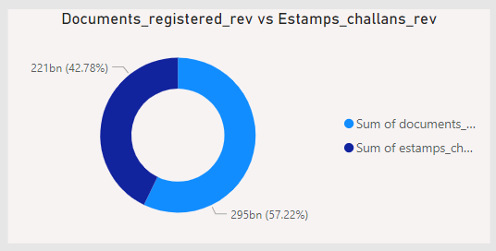
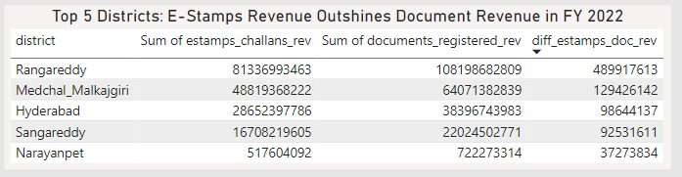
Q. How does the revenue generated from document registration compare to the revenue generated from e-stamps challans across districts? List down the top 5 districts where e-stamps revenue contributes significantly more to the revenue than the documents in FY 2022?
Overall (2019-2023) the revenue generated from documents registration (57.22%) is higher than revenue generated from estamps challans (42.78%). It is because estamps challans came into practice almost from jan 2021. Thus the cumulative sum of estamps is less than document registration revenue
After which in many district estamps challans gradually increased and also become higher than document registered revenue.
E-stamp challans are favored over traditional document registration due to their efficiency, convenience, and cost-effectiveness. These electronic systems offer speed, accuracy, and transparency in stamp duty calculations, promoting digital record-keeping and enabling remote transactions. Government initiatives, anti-fraud measures, and integration with other processes further contribute to the widespread adoption of e-stamp challans.

Slide 9
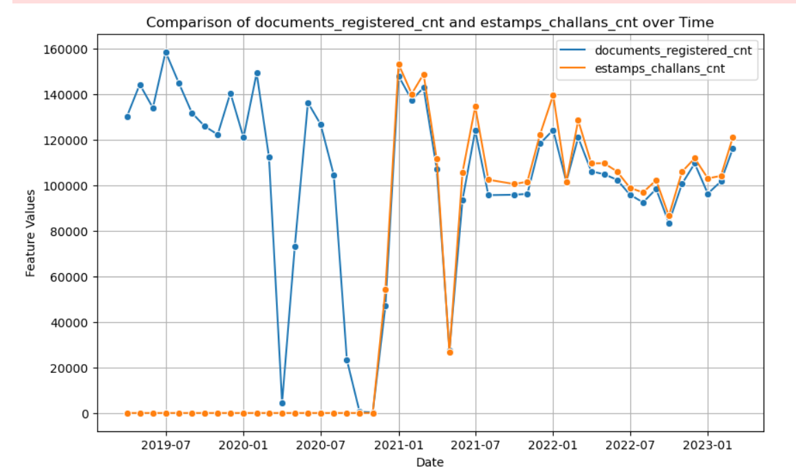
Q. Is there any alteration of e-Stamp challan count and document registration count pattern since the implementation of e-Stamp challan? If so, what suggestions would you propose to the government?
Implementation of estamps challans started from dec -2020. And its usage started increasing gradually because of easy to use feature from anywhere at anytime .

Slide 10
This indicates people are more comfortable through online proces of estamps as it done anywhere at anytime. Government should take steps:
1. Online Platforms and Portals:
- Establish user-friendly online platforms and portals for e-stamping services. This makes it easier for individuals and businesses to access and use e-stamping services, reducing the need for physical visits to government offices.
2. Public Awareness:
- Conduct public awareness campaigns to educate citizens, businesses, and professionals about the benefits of e-stamping.
3. Accessibility and Inclusivity:
- Ensure that e-stamping services are accessible to a wide range of users, including those in rural areas or with limited access to technology. This may involve establishing physical service centers or mobile solutions to reach a broader audience.
4. Data Security and Privacy:
- Implement robust data security measures and privacy protections to safeguard sensitive information collected during the e-stamping process. Compliance with data protection regulations is crucial for user trust and legal compliance.
5. Electronic Payment Systems:
- Facilitate electronic payment options for stamp duty fees. This reduces the need for physical cash transactions and enhances the efficiency of the payment process.

Slide 11
TRANSPORTATION

Slide 12
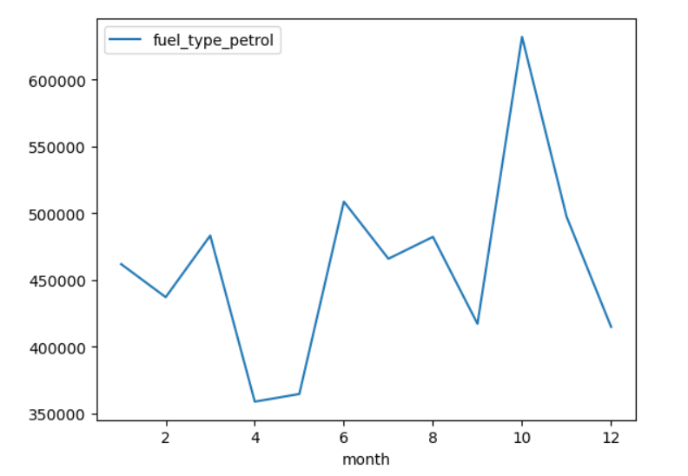
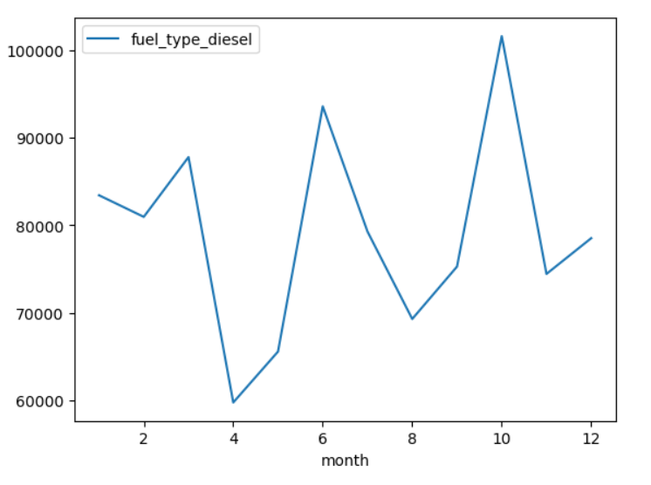
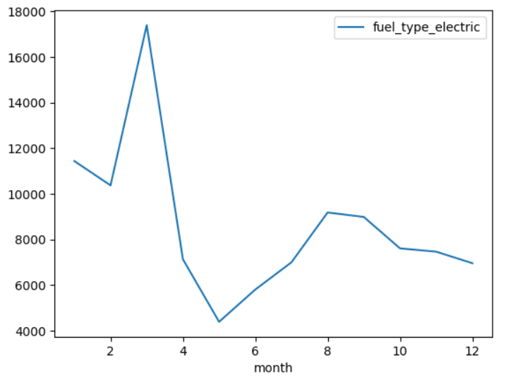
Q. Investigate whether there is any correlation between vehicle sales and specific months or seasons in different districts. Are there any months or seasons that consistently show higher or lower sales rate, and if yes, what could be the driving factors? (Consider Fuel-Type category only)
For petrol the sales are highest during the month of October and lowest during April and May.
For diesel the sales are highest during the month of October and lowest during April and May.
For electric the sales are highest during march and least during may. By comparing y-axis we can say usage of electric vehicles is least. The lower adoption of electric vehicles (EVs) compared to petrol and diesel vehicles is primarily due to high initial costs, limited driving range, longer charging times, perceived inconvenience, and concerns about battery life and replacement costs. Additionally, a lack of charging infrastructure, limited model availability, and consumer habits contribute to the slower uptake of EVs. Efforts to address these challenges, along with supportive policies, are essential for promoting widespread adoption of electric vehicles.

Slide 13
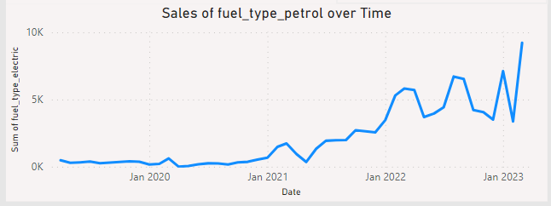
1. Government Incentives:
- India has implemented various incentives and subsidies at both the central and state levels to encourage electric vehicle adoption. This includes reduced GST (Goods and Services Tax) rates, income tax benefits, and financial incentives for manufacturers.
2. Environmental Awareness:
- With increasing concerns about air pollution in major Indian cities, there is a growing awareness of the environmental benefits of electric vehicles. Consumers are increasingly viewing EVs as a cleaner and more sustainable transportation option.
3. Expansion of Charging Infrastructure:
- The Indian government has been actively working on expanding the charging infrastructure. Initiatives like the FAME (Faster Adoption and Manufacturing of Hybrid and Electric Vehicles) scheme aim to establish a robust charging network, reducing range anxiety and promoting EV .
4. Rising Fuel Prices:
- The volatility in fuel prices in India has made electric vehicles more attractive to consumers. EVs offer a cost-effective and stable alternative, especially considering the lower operational costs associated with electricity.
5. Market Competition and Innovation:
- Increased competition among automakers in India's electric vehicle market has led to innovative offerings and competitive pricing. This has made electric vehicles more accessible to a broader range of consumers.
The use of electric vehicle gradually increased from 2020 to 2023

Slide 14
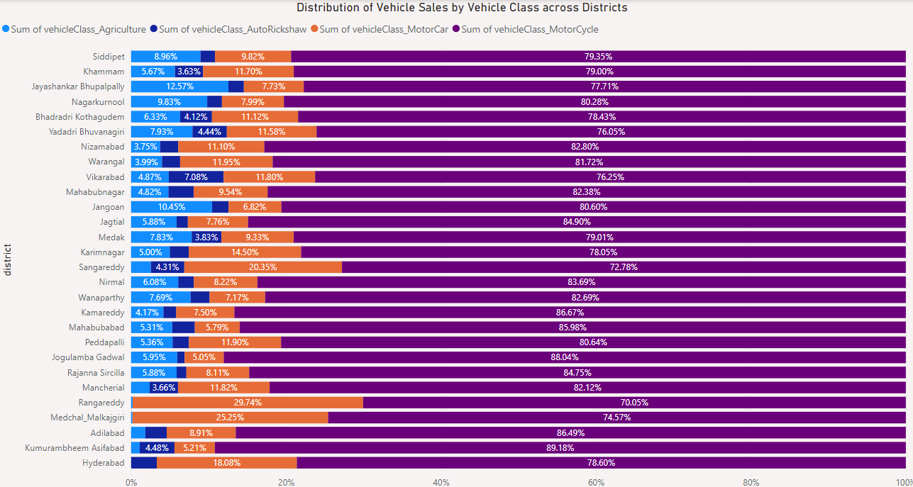
Q. How does the distribution of vehicles vary by vehicle class (MotorCycle, MotorCar, AutoRickshaw, Agriculture) across
different districts? Are there any districts with a predominant preference for a specific vehicle class? Consider FY 2022
for analysis.

Slide 15
Insights:
In very district atleast 70% of vehicles is under vehicle class Motor Cycle which says than motor cycle is used most in every district.
In urbanized areas like Hyderabad, Rangareddy, and Medchal Malkajgiri, factors such as rapid urbanization, limited agricultural land, higher demand for personal vehicles, and infrastructure development contribute to the lower usage of agricultural vehicles compared to cars and motorcycles. The shift from agriculture to non-agricultural activities in these regions further diminishes the need for specialized agricultural vehicles.
In districts like Jayashankar Bhupalpally and Jaagaon, higher usage of agricultural vehicles is driven by the dominance of agriculture in the local economy, the presence of extensive agricultural land, reliance on traditional farming practices, and the economic dependency on agriculture.
The usage of autorickshaw is almost same in every district while the lack of autorickshaw usage in Rangareddy and Medchal Malkajgiri may be attributed to factors such as the prevalence of personal vehicles, the availability of alternative modes of transportation, and limited demand for autorickshaws in these relatively urbanized and well-connected districts.

Slide 16
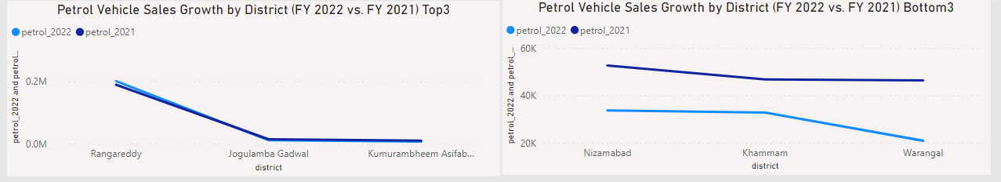
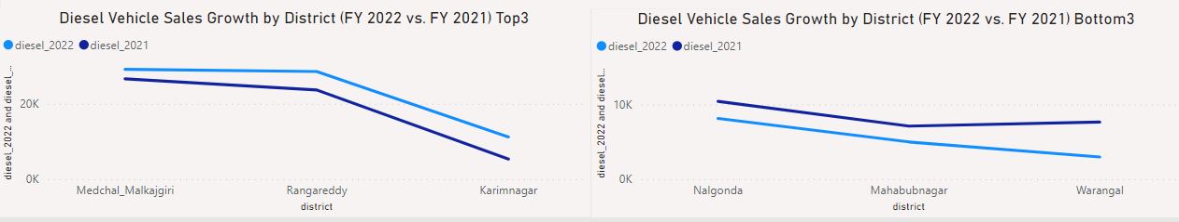
Q. List down the top 3 and bottom 3 districts that have shown the highest and lowest vehicle sales growth during FY 2022 compared to FY 2021? (Consider and compare categories: Petrol, Diesel and Electric)
The use of petrol has decreased in 2022 compared to 2021 except for Rangareddy.
The use of diesel has increased for some districts while decreased for some districts compared to last year

Slide 17
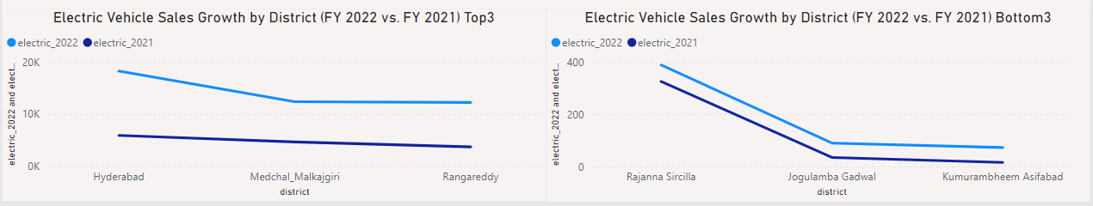
The use of electric vehicles increased in 2022 compare to 2021.
Reasons for increase in usage of electric vehicles and decrease in usage of petrol and diesel vehicles:
This indicates usage of electric vehicles is promoted more in comparsion to petrol and diesel vehicles.
A gradual shift towards electric vehicles could contribute to a decrease in petrol and diesel usage, especially if there are incentives or initiatives promoting cleaner modes of transportation.
The oil price hike also marked people’s preferences, particularly those using personal vehicles. The oil price hike has impacted mostly the middle-class and it has become unbearable for a small-time private employee who wishes to take his/her own ride.
One of the major factors could be the reduction of GST rates on electric vehicles from 12 per cent to 5 per cent in April last year. Subsidies for faster adoption of electric vehicles and total cost of ownership are some of the key factors that might be encouraging people to choose electric vehicles over diesel or petrol variants,

Slide 18
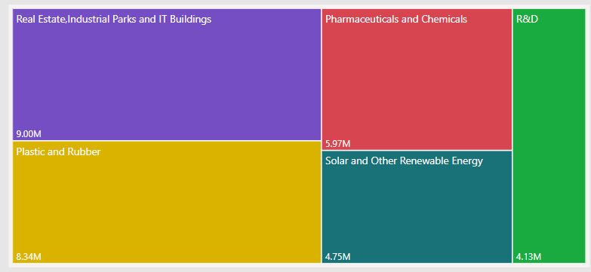
Q. List down the top 5 sectors that have witnessed the most significant investments in FY 2022.
Real estate, industrial parks, and IT buildings attract 68% of investment in Telangana due to robust economic growth, technology hub status, government initiatives, job creation, global competitiveness, strategic location, and a focus on innovation, urbanization, and quality of life.
Real estate is one biggest component of a capex cycle. The housing market has shown significant improvement since 2020 amid a surge in demand for residential property, multi-year low inventory levels, and decadal high affordability.

Slide 19
Telangana state contributes nearly one-third to India’s production and one-fifth to its exports in the pharmaceutical sector. Telangana is pharmaceutical manufacturing hub in the country attracts over Rs 10,000 crore (US$ 1.49 billion) investments in the life sciences sector in the past four years. Pharmaceutical exports also have a majority share in the total merchandise exports from the state. During 2019-20 (up to December 2019) pharmaceutical products exports from the state stood at US$ 3.48 billion. Hyderabad is considered as the Life Sciences Capital of India with over 800 life sciences companies. Over the last four years, Telangana has attracted more than Rs. 10,000 crore investment in the life sciences sector.
Vision 2030: To become the leading life-sciences hub in Asia through innovation-driven & tech- enabled growth, while doubling the sectoral value to USD 100 Billion and adding 400,000 new jobs.
Telangana is one of the the leading states for manufacturing of moulds and tooling for FMCG products.Telangana has a strong presence of plastics industry with about 6,000 units operating in the State, of which about 90 per cent are MSMEs.The organized plastics sector employs more than 1+ lakh people.
These industries contribute to a turnover of over Rs 6,000 crore. And the production capacity is 9 lakh metric tonnes. Of these 6,000 units, 28 per cent are micro, 55 per cent are small, 15 per cent are medium while the remaining 2 per cent are large scale companies.

Slide 20
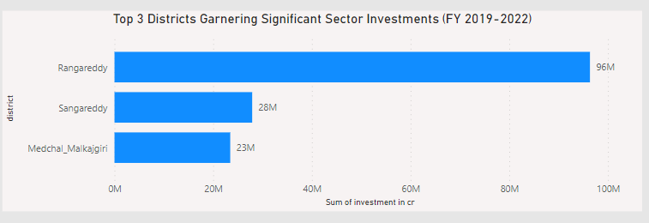
Q. List down the top 3 districts that have attracted the most significant sector investments during FY 2019 to 2022? What factors could have led to the substantial investments in these particular districts?
The top 3 districts that have attracted the most significant sector investments during FY 2019 to 2022 are:
Rangareddy
Sangareddy
Medchal-Malkajgiri
The growth of real estate, pharma, plastics & rubber, engineering and R&D in these districts could be the reason for substantial investments in these districts.

Slide 21
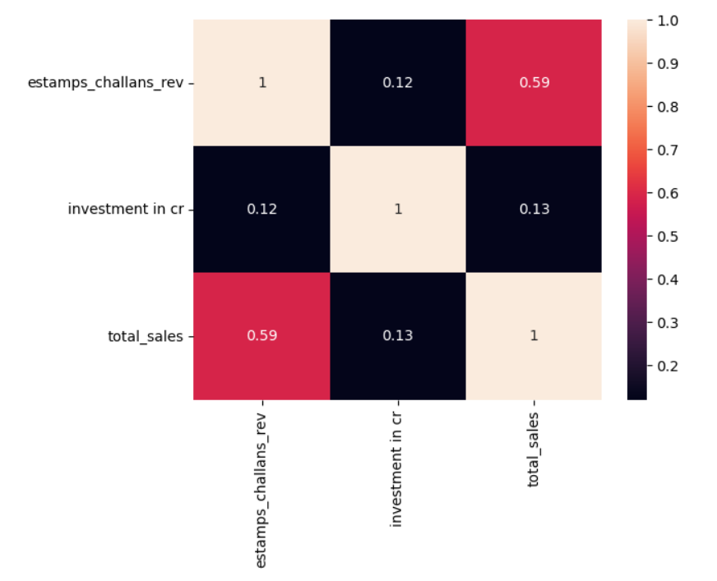
Q. Is there any relationship between district investments, vehicles sales and stamps revenue within the same district between FY 2021 and 2022?
Less value of correlation indicates there is no much correlation between district investments, vehicles sales and stamps revenue

Slide 22
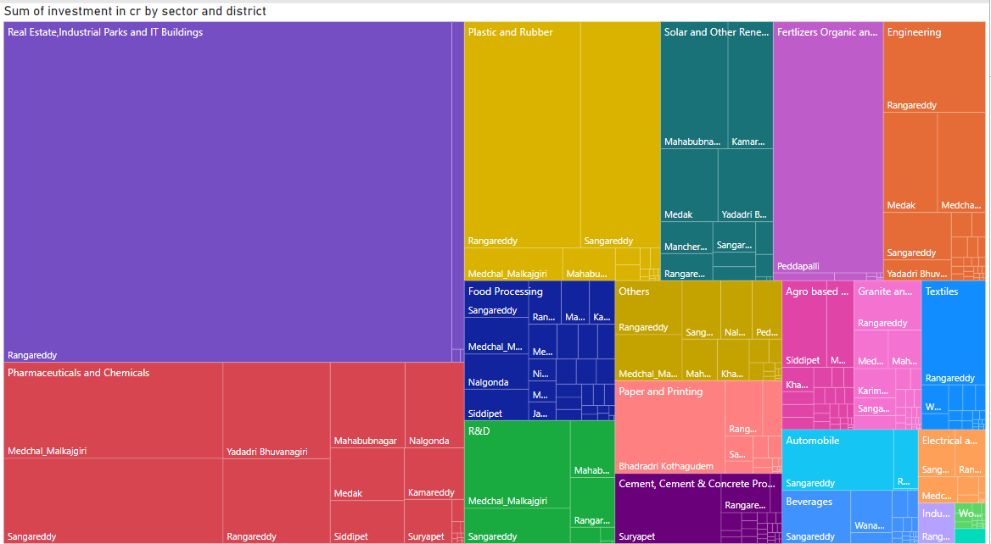
Q. Are there any particular sectors that have shown substantial investment in multiple districts between FY 2021 and 2022?
As we can see from the treemap majority all sectors are in multiple districts

Slide 23
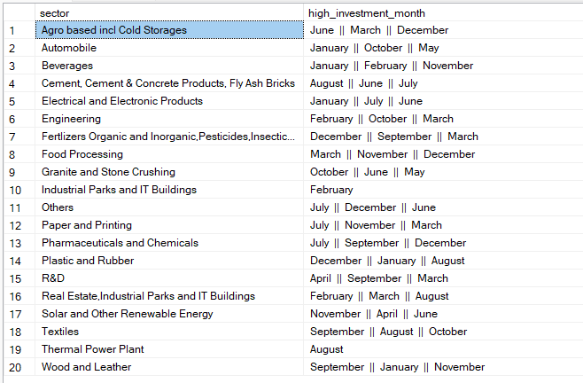
Q. Can we identify any seasonal patterns or cyclicality in the investment trends for specific sectors? Do certain sectors experience higher investments during particular months?
This table shows the top 3 months during which a particular sector had highest investment.

Slide 24
Reasons why a particular sector has higher investment during few months:
1. Agro-based incl Cold Storages (June, March, December):
- Reasons:
- June: Investment in agriculture may peak as it is the beginning of the monsoon season, crucial for crop growth.
- March: Preparing for the upcoming agricultural season, farmers and businesses invest in infrastructure and cold
storages.
- December: Post-harvest season, there might be increased investments in cold storages for preserving agricultural produce.
2. Automobile (January, October, May):
- Reasons:
- January: New models are often launched at the beginning of the year, driving investments in production and marketing.
- October: Festive season boosts consumer spending on automobiles.
- May: Seasonal demand and preparation for the summer season may drive increased investment.
3. Beverages (January, February, November):
- Reasons:
- January and February: Winter season might boost sales of hot beverages.
- November: Preparing for the festive season, there may be increased demand for various beverages.
4. Cement, Cement & Concrete Products, Fly Ash Bricks (August, June, July):
- Reasons:
- August and June: Construction activities typically peak during the monsoon break, leading to increased demand for building materials.
- July: Post-monsoon, construction resumes, and infrastructure projects may drive investments.
5. Electrical and Electronic Products (January, July, June):
- Reasons:
- January: Post-holiday season, there might be increased consumer spending on electronic products.
- July and June: Monsoon-related disruptions may lead to increased investments in electronic infrastructure.

Slide 25
6. Engineering (February, October, March):
- Reasons:
- February and October: Seasonal demands and industrial planning may drive investments in engineering projects.
- March: Preparing for the fiscal year-end, businesses may allocate funds to engineering projects.
7. Fertilizers Organic and Inorganic, Pesticides, Insecticides, and Other Related (December, September, March):
- Reasons:
- December: Preparing for the Rabi season, there may be increased demand for fertilizers and related products.
- September and March: Investments may be made in preparation for the Kharif and Rabi seasons.
8. Food Processing (March, November, December):
- Reasons:
- March and December: Seasonal variations in crop production may drive investments in food processing.
- November: Festive season demand for processed foods may lead to increased investments.
9. Granite and Stone Crushing (October, June, May):
- Reasons:
- October and June: Construction activities often peak during these months, increasing demand for granite and stone.
- May: Pre-monsoon preparation for construction projects may boost investments.
10. Industrial Parks and IT Buildings (February):
- Reasons:
- February: Strategic planning for the upcoming fiscal year may lead to increased investments.

Slide 26
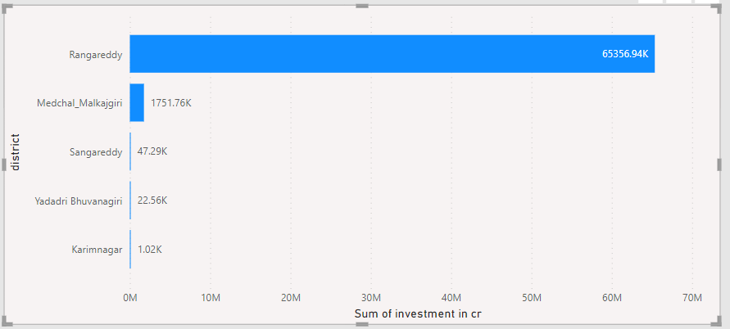
Q. What are the top 5 districts to buy commercial properties in Telangana? Justify your answer.
Rangareddy, Medchal_Malkajgiri, Sangareddy, Yadadri Bhuvanagiri, Karimnagar are top 5 district to buy commercial properties in Telengana.

Slide 27
1. Rangareddy:
- Proximity to Hyderabad, the capital city, making it a strategic location for businesses.
- Well-developed infrastructure and connectivity, attracting commercial establishments.
2. Medchal_Malkajgiri
- Close proximity to Hyderabad, contributing to its urban development.
- Availability of land for commercial development and infrastructure projects.
3. Sangareddy:
- Strategic location and connectivity, making it attractive for commercial investments.
- Industrial growth and development of business-friendly policies.
4. Yadadri Bhuvanagiri:
- Proximity to Hyderabad and strategic location along major transportation routes.
- Infrastructure development and government initiatives promoting commercial activities.
5. Karimnagar:
- Growing urbanization and industrialization, fostering commercial development.
- Government focus on infrastructure and economic development in the region.
These reasons are indicative and may involve a combination of factors such as geographic location, infrastructure, government policies, and economic trends contributing to the prominence of commercial properties in these districts.

Slide 28
Q. What significant policies or initiatives were put into effect to enhance economic growth, investments, and employment in Telangana by the current government? Can we quantify the impact of these policies using available data?
TS-iPASS – Single window clearance, deemed approval (attracted ₹991bn)
MANA OORU MANA BADI – School infrastructure development (Benefited 19.84 lakh students)
RYTHU BANDU – To enhance agricultural productivity & income for farmers
TASK – To improve the skills of graduates
T-HUB - Synergies startups, corporations, governments, academia and investors to drive transformative change

Slide 29
Provide top 5 Insights & 5 recommendations to the Telangana government for sustained growth in the next 5 years based on your analysis.
Top 5 Insights:
Medchal-Malkajgiri is one of the top revenue-generating districts in Telangana in terms of revenue and growth percentage between fiscal year 2019 and fiscal year 2022.
E-stamp revenue is higher in and around the state capital, Hyderabad. Total stamp revenue is also high in the same areas.
Khammam district is among the top 5 districts in sales of agricultural vehicles, autorickshaws, and motor cars. Hyderabad district has the highest sales of motorbikes.
Khammam district's electric vehicle sales in the fiscal year 2022 were four times higher than in fiscal year 2021. Warangal district saw a decline of approximately 50% in petrol and diesel vehicle sales and a 58% increase in electric vehicle sales.
Rangareddy, Sangareddy, and Medchal-Malkajgiri have attracted more investments between fiscal year 2019 and fiscal year 2022, with most of the investments going into real estate, pharmaceuticals, plastics, engineering, and research and development.

Slide 30
Top 5 Recommendations:
Promote tourism: Telangana has a rich history and culture, which can be a major source of tourism revenue. The government should focus on promoting tourism by developing tourist destinations, improving infrastructure, and providing marketing support.
Improve the quality of education and healthcare: The quality of education and healthcare are important determinants of the state's human capital. The government should focus on improving the quality of education and healthcare by providing better infrastructure, training, and facilities. The government should also focus on making education and healthcare more accessible to all sections of society.
Encourage R&D: Research and development is essential for innovation and economic growth. The government should encourage research and development by providing funding, tax incentives, and other support to researchers and scientists.
Partner with the private companies: The government should partner with the private companies to develop the economy. This can be done by collaborating on projects and sharing resources.
Empower women: Women play a vital role in the economy. The government should focus on empowering women by providing them with education, skills training, and access to credit.

